Slide 1


Workplace Intelligence
Solution Accelerator
Product development teams
Gain data-driven insights to help product teams unleash their true potential
Product developers need to be as productive and efficient as possible to deliver innovative high-quality products and services. Workplace insights can help pinpoint the processes and tools that boost performance and worker wellbeing.
The Workplace Intelligence Solution Accelerator is a packaged analytical BI application that helps you uncover and leverage the key drivers of productivity and success for product development teams. It provides a holistic view of data from existing Microsoft tools and is securely deployed on Azure within your own environment.
Challenges
Workday practices are difficult to measure and understand what changes could enable productivity
Sources of tech debt are challenging to identify
Data-driven insights on solution performance are needed to determine which tool is best for a given task
Institutional knowledge is lost when top performers leave their jobs
Product quality and release velocity are impacted when teams work with incomplete and inaccurate metrics
87% of companies are experiencing a talent shortage. The global tech talent shortage equated to 40 million unfilled jobs in 2020.
Benefits
Pinpoint and reduce sources of tech debt, distraction, and disruption
Reduce friction by optimizing tools to automate task and workflow initiation
Find and replicate processes that
maximize developer productivity
Build a holistic solution with tools already in your environment
Identify the best technologies for a given task or function
Create a strong technical culture by retaining most talented developers
©Microsoft Corporation. All rights reserved.

Slide 2
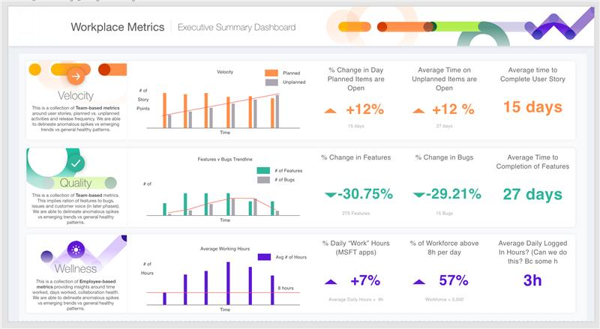
Workplace metrics viewed holistically through a single dashboard
View the details of your product development teams’ projects to help optimize their performance.
Learn where your teams succeed or struggle to enable changes in schedules or tasks that empower them to focus, grow, and create.
Gain insights that help your development teams reach their true potential
Kick-off
Proof of value
Proof of concept
Learn more about the Workplace Intelligence Solution Accelerator and see a demo.
See a deeper platform demonstration based on your product development teams’ specific workflow and work volume needs.
Build and deploy a POC with the support of your Microsoft technical specialist and partners.
With your content and workflow, create POV in 1-3 days.
With ECIF-funded backend integration, create a POC in 2-5 weeks.
Join the Workplace Intelligence Solution Accelerator pilot program
For a limited time, Microsoft is offering a special pilot program for the Workplace Intelligence Solution Accelerator to customers interested in helping us shape the solution roadmap. Financial offsets may be available to cover pilot program costs.
Get started today
Contact your Microsoft specialist for a demo, pilot program details, and next steps.
©Microsoft Corporation. All rights reserved.

